Slide 1
CHART PATTERNS

Slide 2
Chart Patterns
Usually occur in an uptrend or downtrend as a pause before head towards the preceding trend or change of trend
Mainly two types of patterns.
Reversal Patterns
Continuation Patterns

Slide 3
Volume
Number of shares traded in market during given period of time.
Amount of shares that trade hands from seller to buyer.
Increase in volume indicate trend might continue in that direction.
Decrease in volume indicate trend might change.

Slide 4
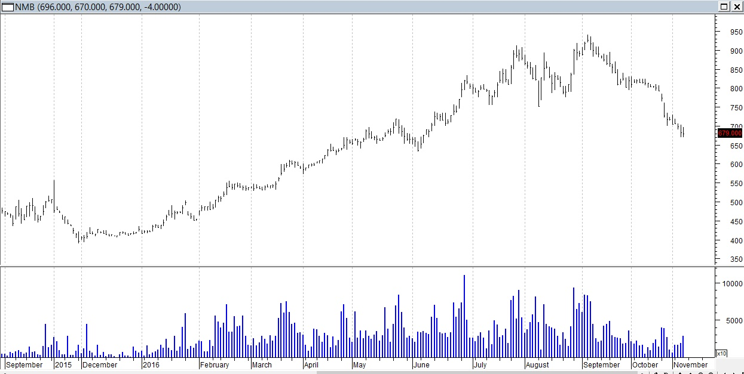
Volume is recorded at the bottom of the chart.

Slide 5
Common Chart Patterns
Head and Shoulder
Triple Tops and Bottoms
Double Tops and Bottoms
Symmetrical Triangle
Ascending Triangle
Descending Triangle
Flags and Pennants
The Falling Wedges
The Rising Wedges
Rectangle
Broadening Triangle
Cup with Handle
Rounding Bottom or Saucer

Slide 6
Reversal Patterns – Common points
Occurs in uptrend or downtrend
Penetration of important trendline
Larger the pattern, greater the effect
Volume plays important role

Slide 7
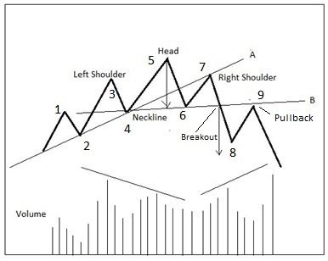
Head and Shoulder
Major reversal pattern
Looks like head and shoulders
Indicates buying pressure getting weak in an uptrend
Volume increases as price declines
Pull back is normal

Slide 8
Head and Shoulder
Locating Price Targets
Measure height of a pattern
Vertical distance between head and neckline
Project it from the breakout on the neckline
Pattern works most of the time but not always

Slide 9
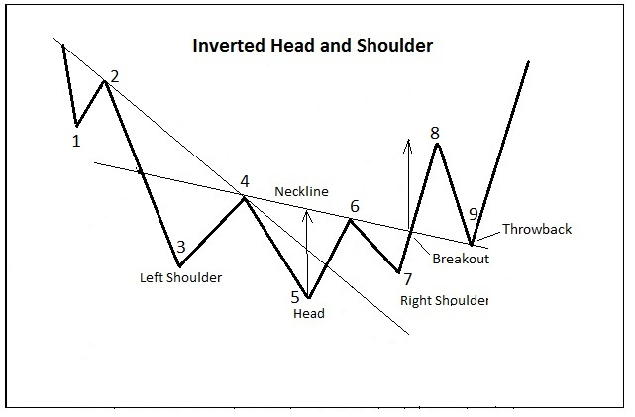
Inverted Head and Shoulder
Opposite of the head and shoulder pattern
Occurs in downtrend at the bottom
Volume increases as price starts to increase
Price target is similar as head and shoulder pattern

Slide 10
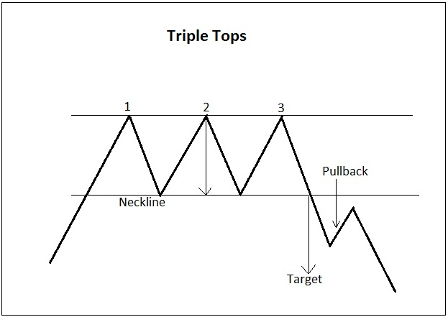
Triple Tops
Similar as head and shoulder but with no head
Peaks are in similar level
Occurs in an uptrend
Volume increases as price breaks neckline
Pullbacks are normal

Slide 11
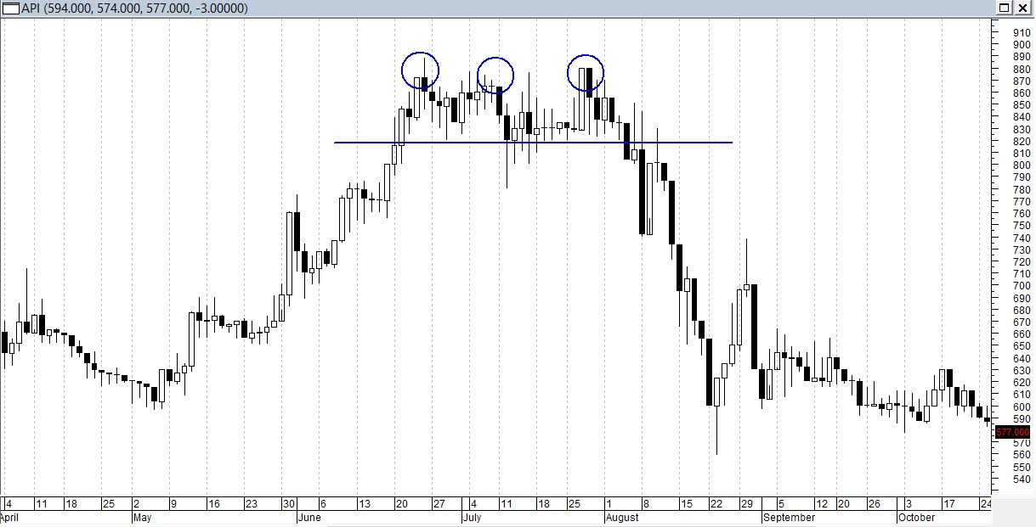
Triple Tops

Slide 12
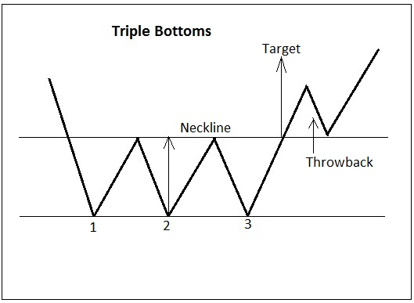
Triple Bottoms
Just the opposite of the triple tops
Occurs in downtrend
All troughs are in similar level
Throwbacks are normal
Volume increases as price hikes up

Slide 13
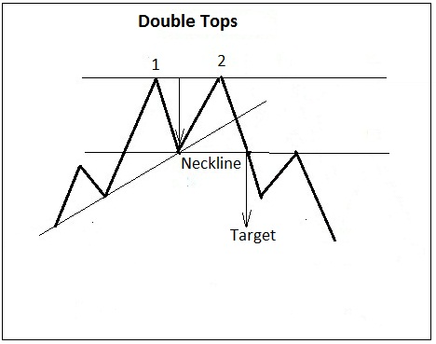
Double Tops
Occurs in uptrend
It involves two peaks and known as ‘M’
Usually volume increases in breakout
Locating price target is similar as other triangle patterns

Slide 14
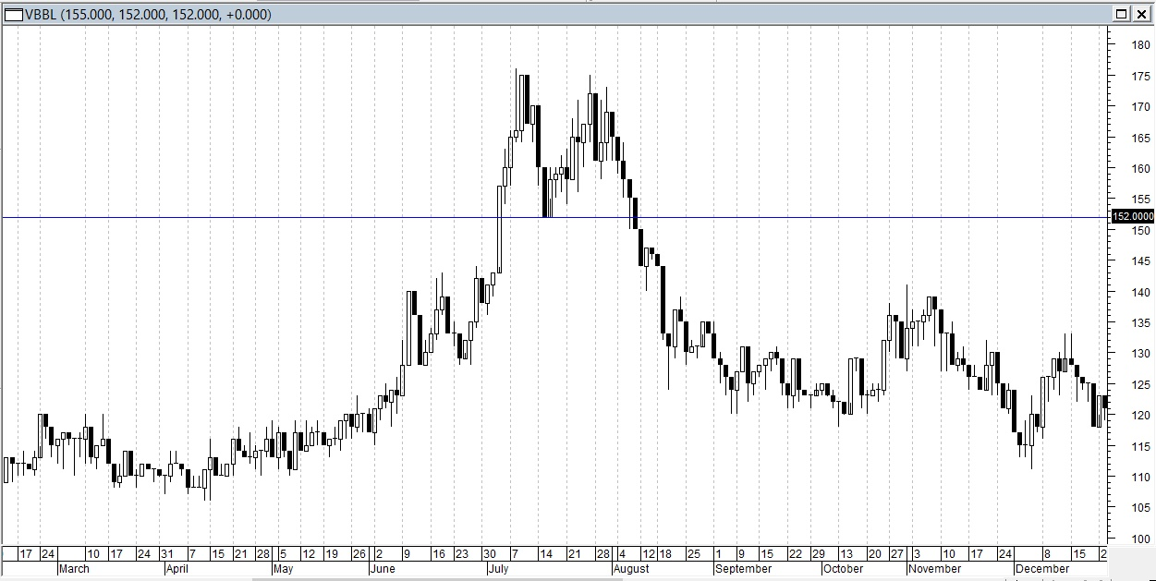
Double Tops
Notes:
Merged with Society Dev Bank and now known as VSDBL

Slide 15
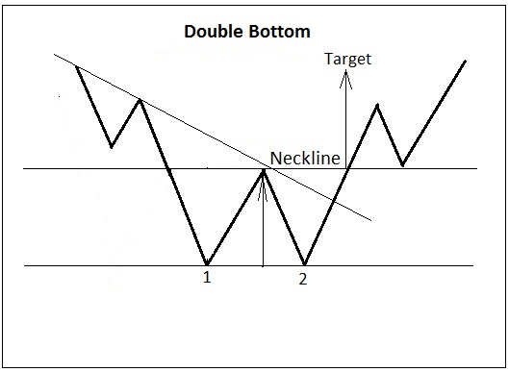
Double Bottoms
Occurs in downtrend
It involves two troughs and known as ‘W’
Usually volume increases in breakout
Locating price target is similar as other triangle patterns

Slide 16
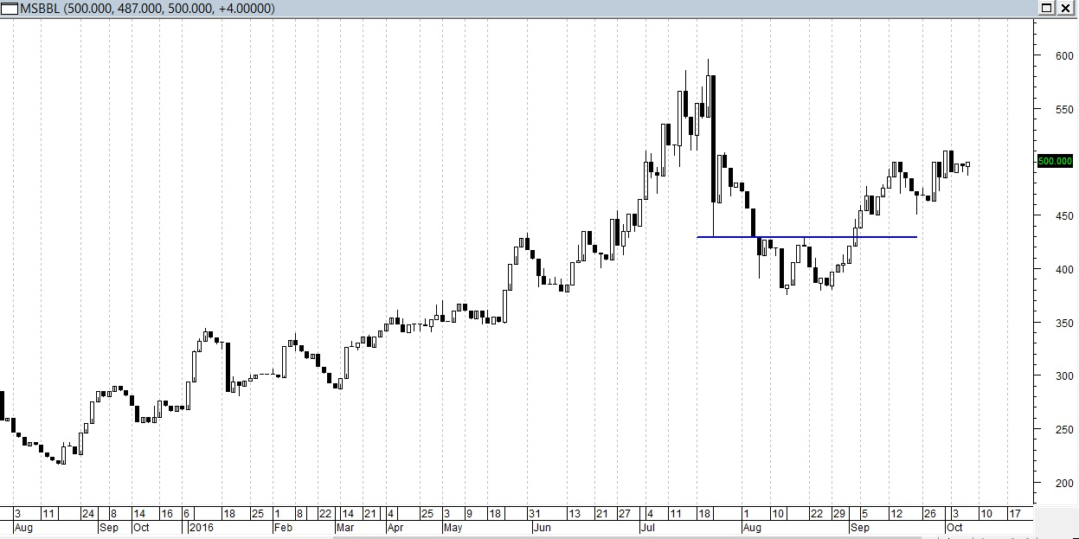
Double Bottoms
Notes:
Manaslu Bikas Bank Ltd

Slide 17
Continuation Patterns
A pause in a trend before moving towards the preceding direction most of the time
Usually shorter term than the reversal patterns
Common types are Triangle, Flags, Pennants & Rectangle Patterns

Slide 18
Triangle Patterns
Symmetrical Triangle
Ascending Triangle
Descending Triangle

Slide 19
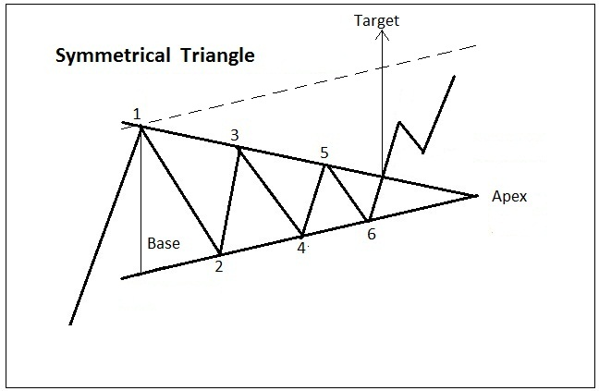
Symmetrical Triangle
2 Converging trendlines
At least 2 peaks and troughs
Indicates buying and selling pressure even
Valid breakout should occur before heading that direction
Volume declines towards apex and increases at breakout

Slide 20
Symmetrical Triangle
General rule breakout at 2/3 to 3/4 from base to apex
Continuous pattern but not always
Known as Coil
Average duration is 1 month to few months

Slide 21
Symmetrical Triangle
Locating Price Target
Measure the height of base and project it from breakout
Draw a trendline parallel to ascending trendline

Slide 22
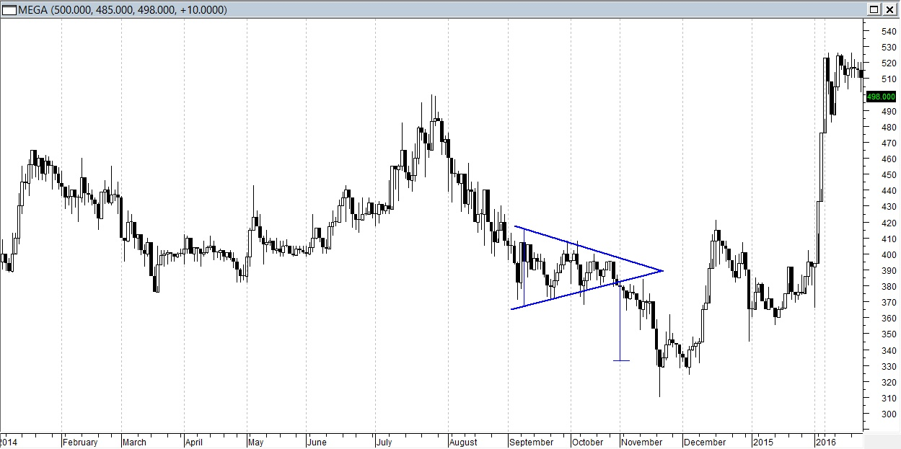
Symmetrical

Slide 23
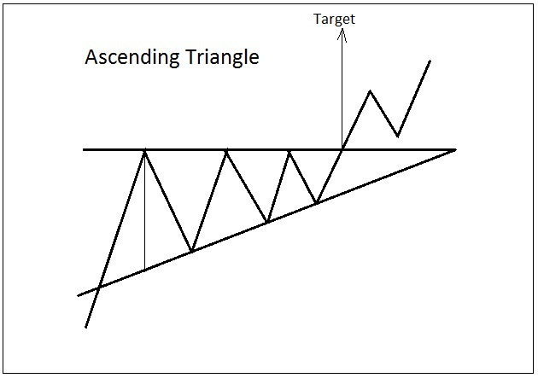
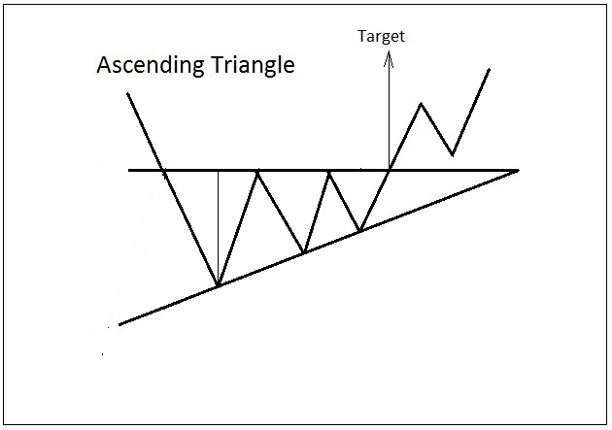
Ascending Triangle
Occurs in uptrend
Bullish pattern
Upper trendline will be flat and lower will ascending
Volume decreases towards apex and increases at breakout
Triangle at bottom will be reversal
Price target will be on basis of height of the base

Slide 24
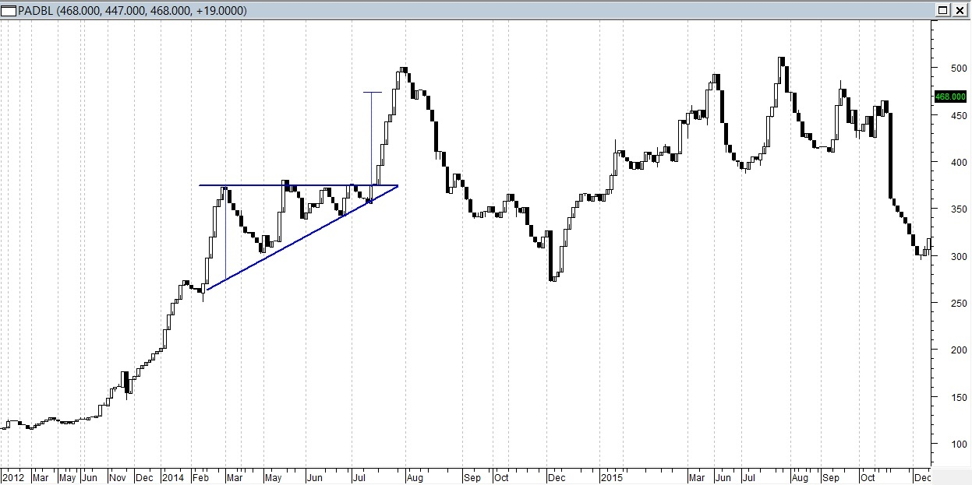
Ascending Triangle
Notes:
Pacific Dev Bank Ltd

Slide 25
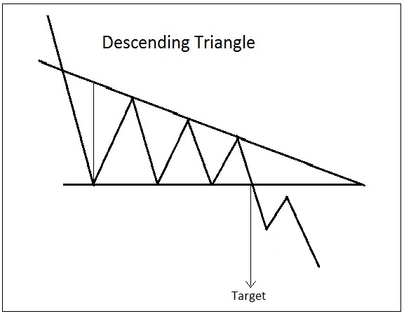
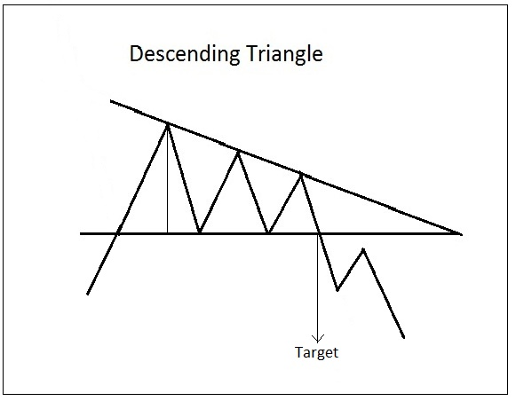
Descending Triangle
Occurs in downtrend
Bearish pattern
Lower trendline will be flat and upper will be descending
Volume decreases towards apex and increases at breakout
Triangle at top will be reversal
Price target will be on basis of height of the base

Slide 26
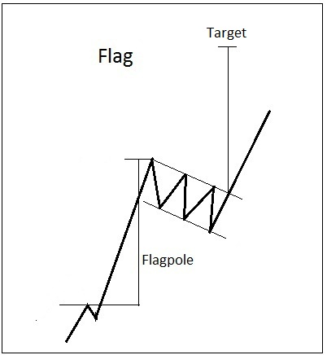
Flag
Looks like rectangle or parallelogram
Occurs in sharp trend for short period of time
Average duration is 1 – 4 weeks
Locating price target is the measurement of the flagpole at breakout

Slide 27
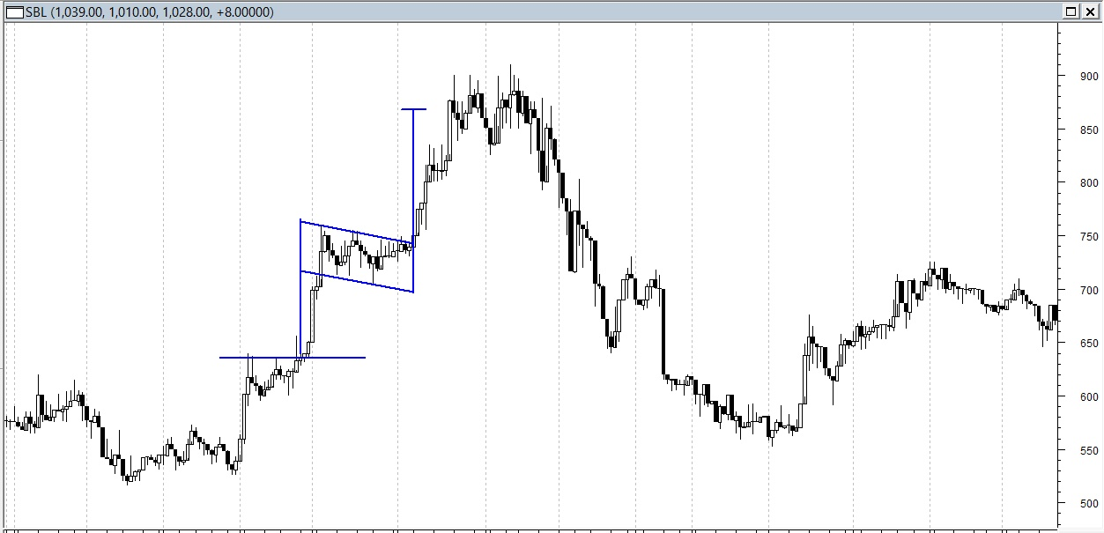
Flag

Slide 28
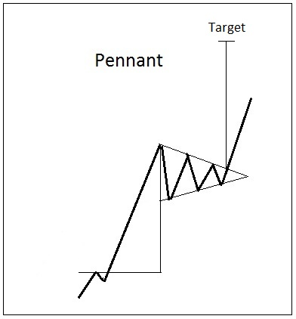
Pennant
Looks like a symmetrical triangle
Occurs in sharp trend for short period of time
Average duration is 1 – 4 weeks
Locating price target is the measurement of the pole at breakout

Slide 29
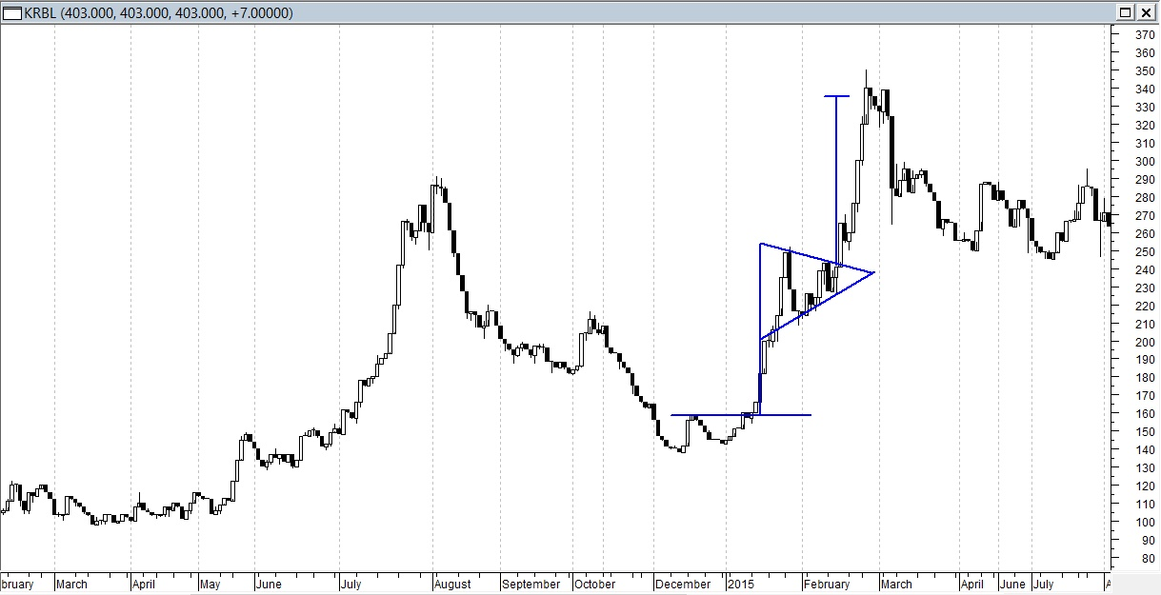
Pennant

Slide 30
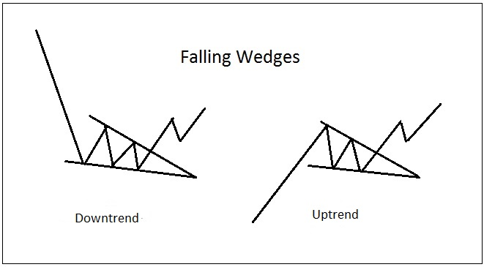
Wedges
Falling Wedges
Looks like symmetrical triangle but tilted downwards
It’s a bullish pattern
Average duration is 1 month to few months
In a downtrend it can be a reversal pattern at bottom
In an uptrend it can be a continuous pattern

Slide 31
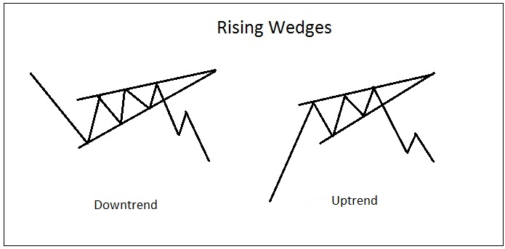
Wedges
Rising Wedges
Looks like symmetrical triangle but tilted upwards
It’s a bearish pattern
Average duration is 1 month to few months
In a downtrend it can be a continuous pattern
In an uptrend it can be a reversal pattern

Slide 32
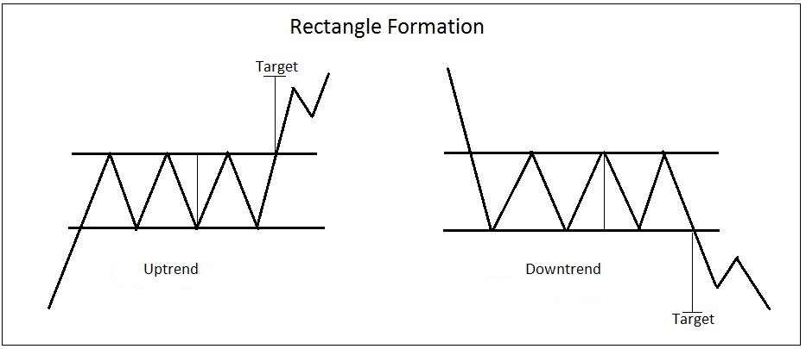
Rectangle
Occurs in uptrend or downtrend as a pause
Minimum 2 peaks and 2 troughs
Average duration is 1 month to few months
Need to be aware that it looks like triple tops and bottoms
Volume importance
Generally longer the pattern, breakout is more significant

Slide 33
Rectangle
Occurs in uptrend or downtrend as a pause
Minimum 2 peaks and 2 troughs
Average duration is 1 month to few months
Need to be aware that it looks like triple tops and bottoms
Volume importance
Generally longer the pattern, breakout is more significant

Slide 34
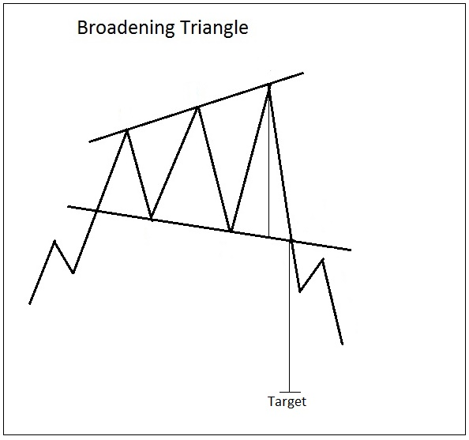
Broadening Triangle
Just like inverted triangle
Trendlines diverge
Generally occurs on market tops therefore, usually bearish formation
Known as megaphone
Volume increases as it broadens indicating, emotional, volatile and public participation

Slide 35
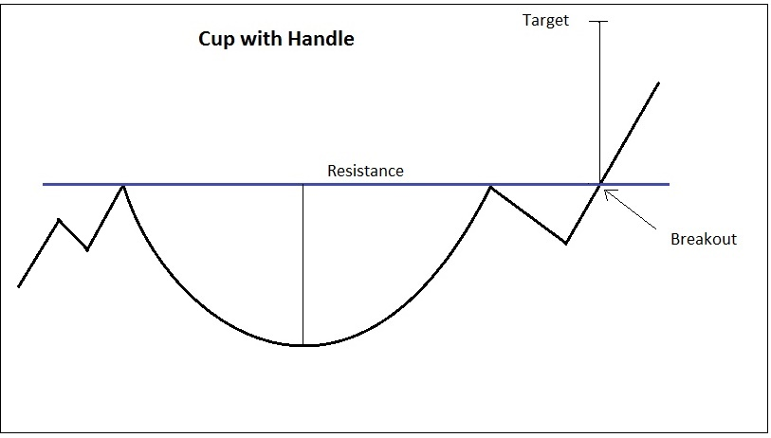
Cup with Handle
Looks like a cup and handle
Bullish pattern
Average duration is from 1 month to many months
Price target can be projected with the depth of the cup from the rim

Slide 36
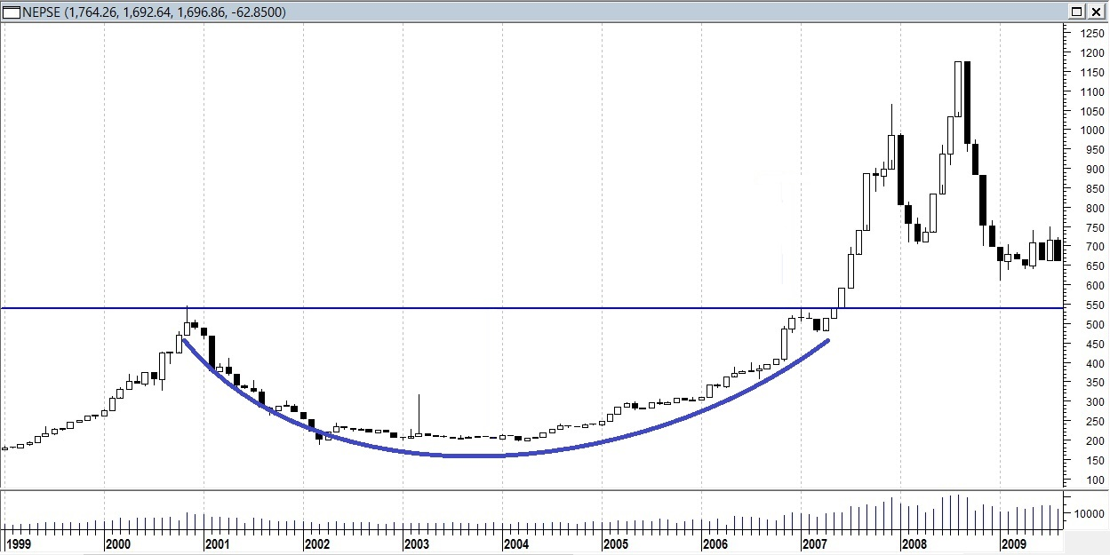
Rounding Bottom or Saucer
Looks like cup and handle but sometimes don’t have handle
Long term pattern
Usually duration of pattern formation is many months to several year
Identified with weekly or monthly chart

Slide 37
- STOP LOSS - TRAILING STOP LOSS

